Slide 1
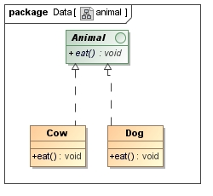
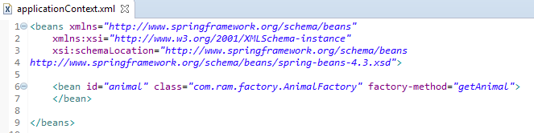
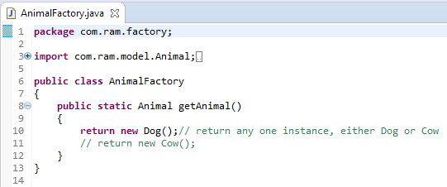
Dependency Injection with static factory method that returns the instance of another class
A static factory method that returns instance of another class.

Slide 2
Dependency Injection with static factory method that returns the instance of another class
What object to instantiate?
What object to configure and how to configure?
Animal
The Spring Container
(ApplicationContext)
applicationContext.xml
Animal(
Dog or Cow)
Object
Create the Animal object.
Configure the Animal object.
Manage Animal object complete life cycle from creation till destruction.

Slide 3
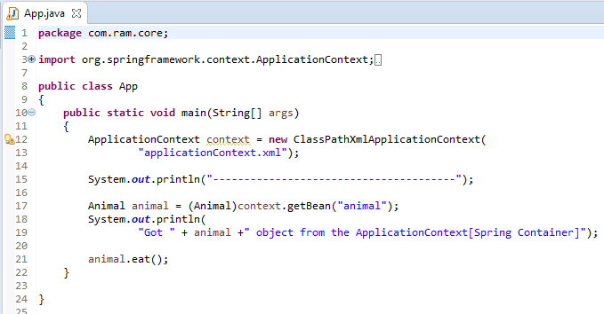
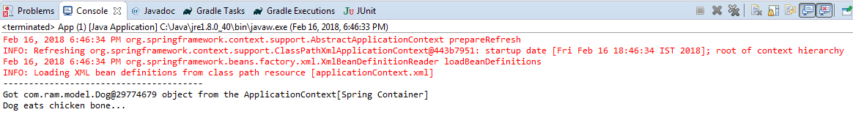
Dependency Injection with static factory method that returns the instance of another class

